Slide 1
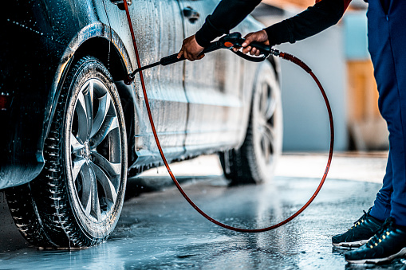

V I Z Z E A S Y
SERVICE IS NOW EASY

Slide 2
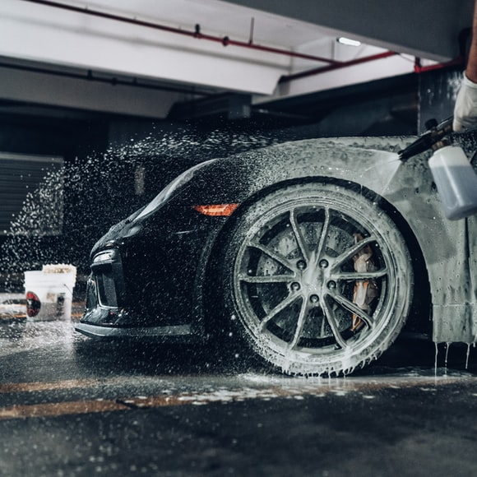
About Us
DRIVE YOUR CLEAN CAR, DAILY.
Vizzeasy offers you an eco-friendly doorstep car washing and dry-cleaning services at an affordable price.
Car cleaning means proper internal cleaning of the vehicle, which only a professional can do properly.
We like empowering our unemployed youth to become a successful entrepreneur in the car cleaning and detailing segment.
An App based cleaning service, where user can track the progress of the service they opted.

Slide 3
WITH VIZZEASY CAR WASH IS NOW EASY
SERVICES WE OFFER
Professional maintenance of car with industry trained and trusted cleaning agents.
Car Health report which helps the car owner to have a heads Up
Car Sanitization
Enjoy Car wash at Home that too at your own time.
VIZZEASY CARES EVERY CAR AS ITS OWN AND GIVEN DETAIL ATTENTION TO EVERY CAR AS FIRST CAR
HATCHBACK , SEDAN, MINI SUV, SUV ARE OFFERED VARIOUS RANGES OF PACKGES WHICH ARE BUDGET FRIENDLY

Slide 4
OUR PRICES
ECO AND BUDGET FRIENDLY IN INR
PACKAGES | HATCHBACK | SEDAN | MINI SUV | SUV
ONE TIME | 699 | 799 | 899 | 999
WEEKLY | 899 | 999 | 1099 | 1199
MONTHLY | 1299 | 1399 | 1499 | 1599

Slide 5
Thank You.
TEAM VIZZEASY
96 76 66 93 43
SERVICES@VIZZEASY.COM
www.vizzeasy.com

